Slide 1
Data visualization final project
StarCraft II: Interactive Game Analytics

Slide 2
Overview
Problem Description
Design Choices
Result

Slide 3
Problem description

Slide 4
Design Choices – (I)
LINE PLOT:
Find trends
Interesting timeframe
MAP OVERVIEW:
Unit positions
Insight into Strategy
Built units

Slide 5
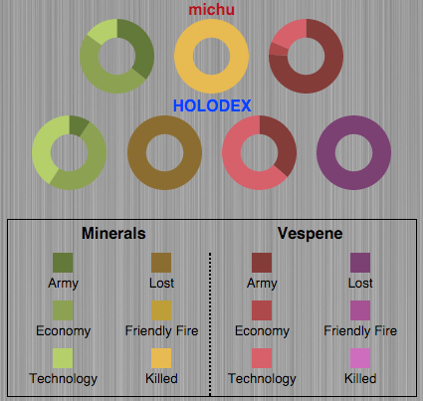
Design Choices – (II)
Donut Chart:
Part-To-Whole Judgments

Slide 6
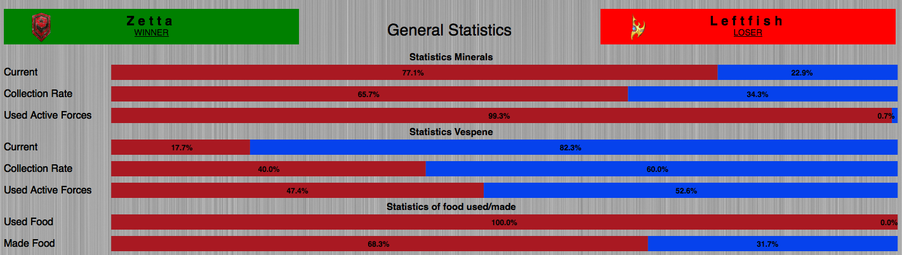
Design Choices – (III)
Stacked Bar Chart:
Part-To-Whole
Change over Time

Slide 7
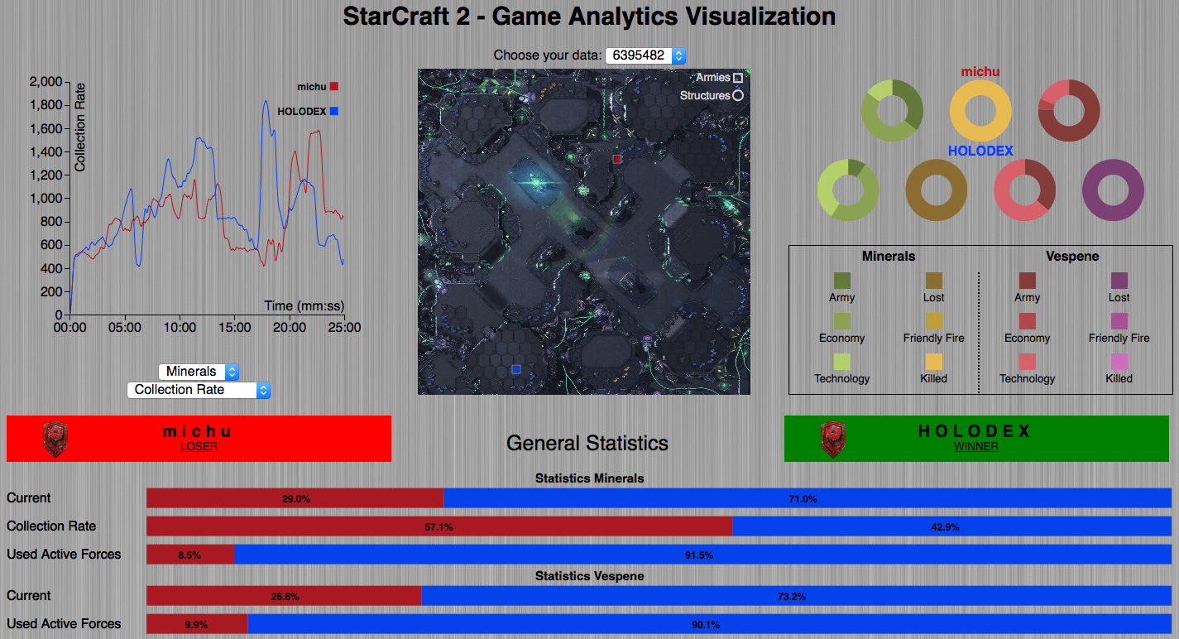
RESULT
Eyes beat Memory
Focus + Context
Filtering & Navigation

Slide 8
QUESTIONS?

